Slide 1


IPL DATA ANALYSIS
Power BI Visualization
Batch Name :- MIP-DA-12
Presented By :- Preet Borad

Slide 2

Table Of Contenets
1
2
3
4
Problem Statement
Project Objective
Insights
Conclusion
Mentorness

Slide 3
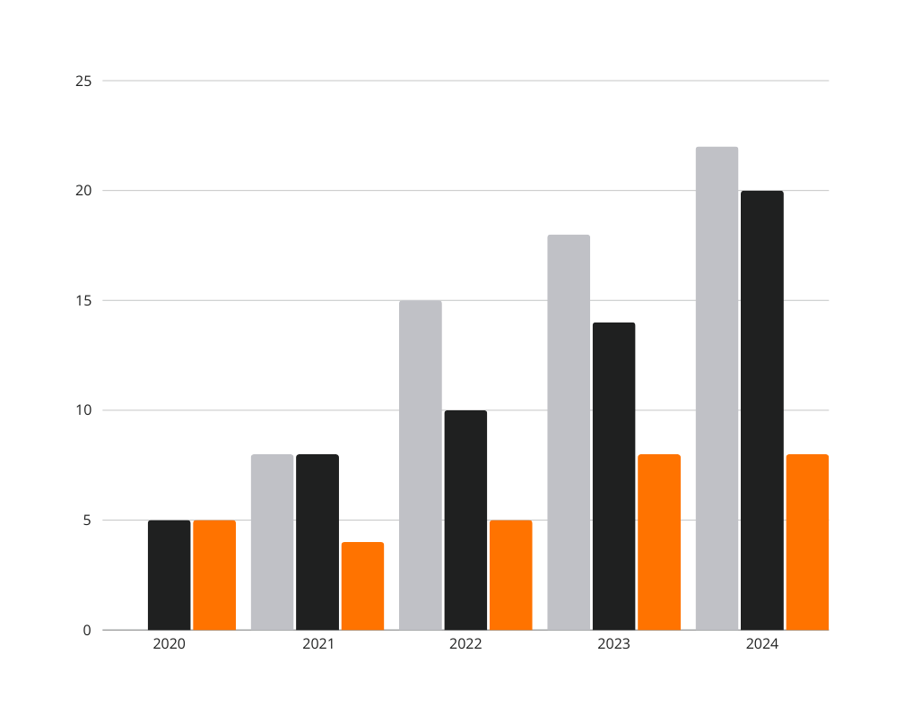
Problem
Satements
This project aims to analyze a dataset of IPL data analysis using Power Bi. This dataset including various attributes like team names, players name, date, match result. The main objective is visualized and analysis of different dataset and focus on find the best insights or patterns and trends
Learn More
Mentorness

Slide 4

Problem Objective
Total
Overview
Match
Analysis
Years
Analysis
Top
Batsman
Top
Bowler
Learn More
Mentorness

Slide 5
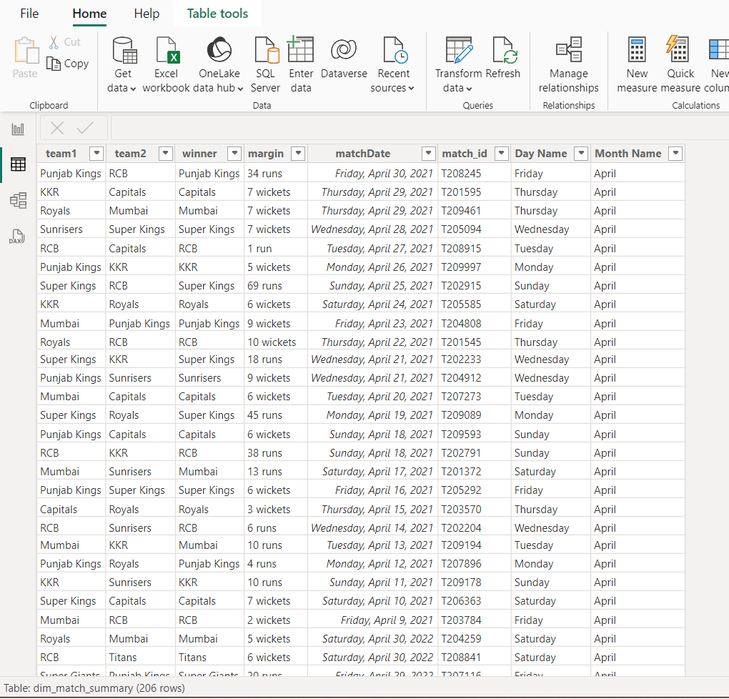
Datasets
1
Learn More
Mentorness

Slide 6
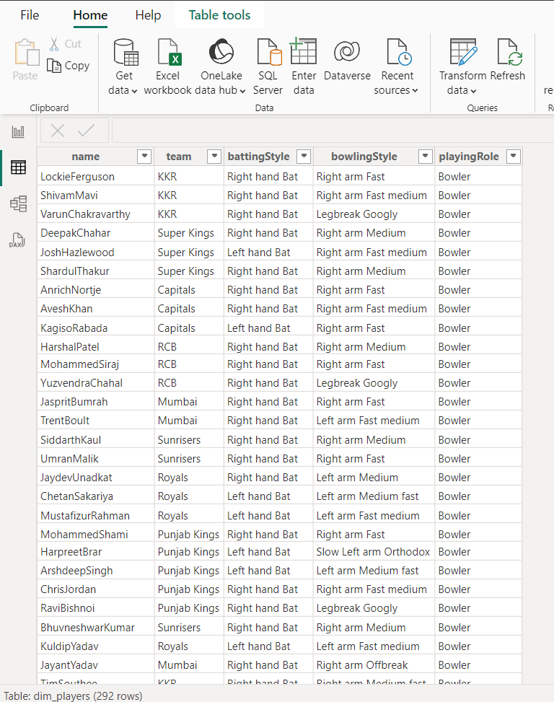
Datasets
2
Learn More
Mentorness

Slide 7
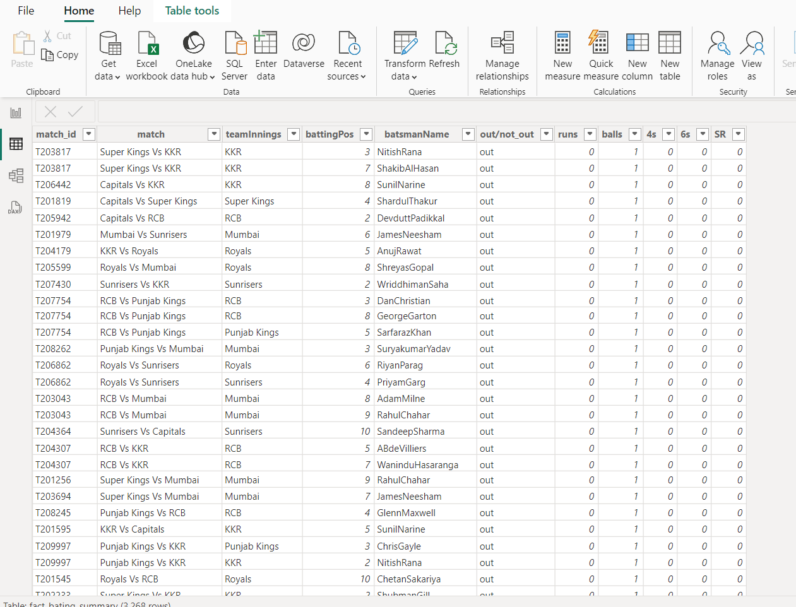
Datasets
3
Learn More
Mentorness

Slide 8
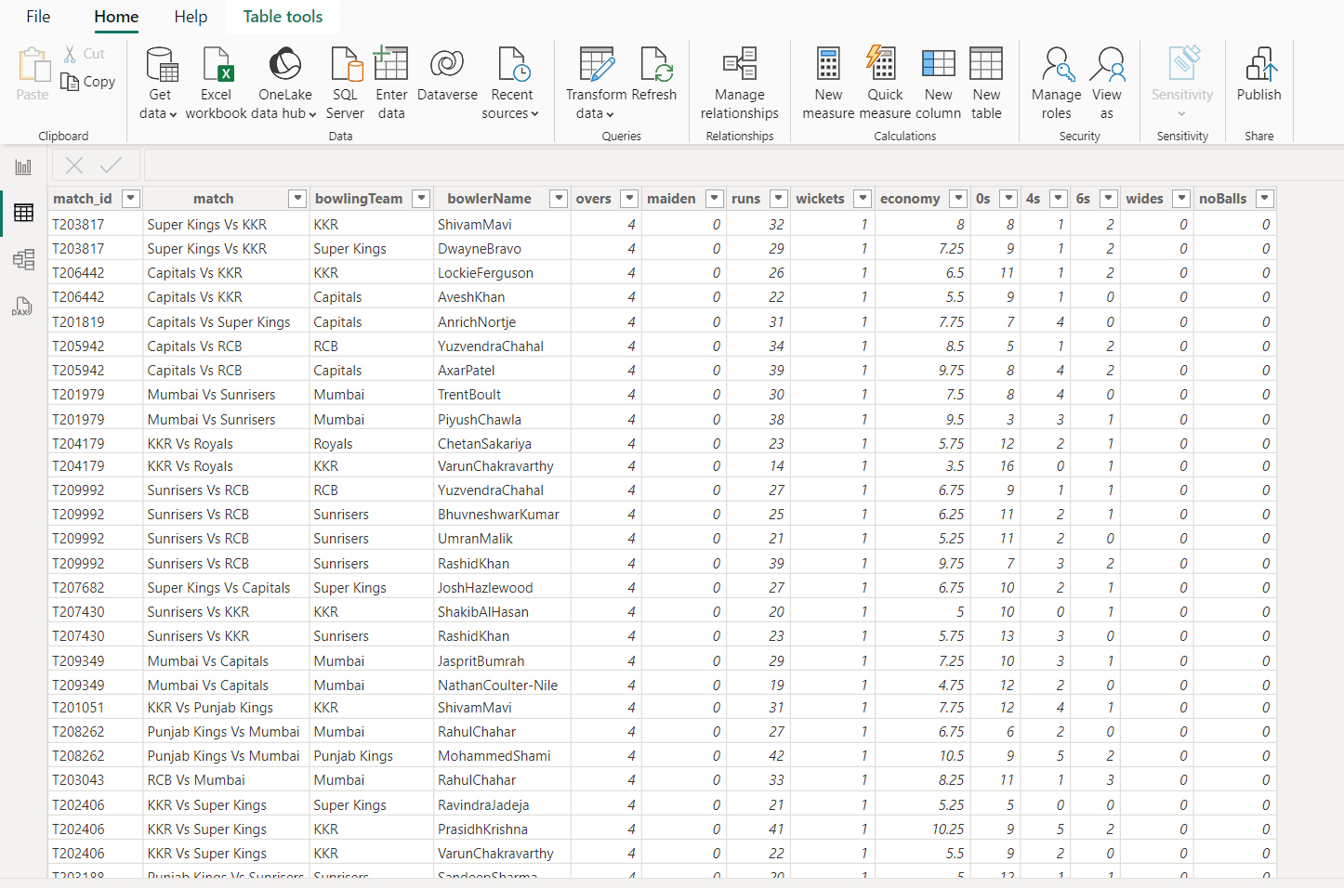
Datasets
4
Learn More
Mentorness

Slide 9
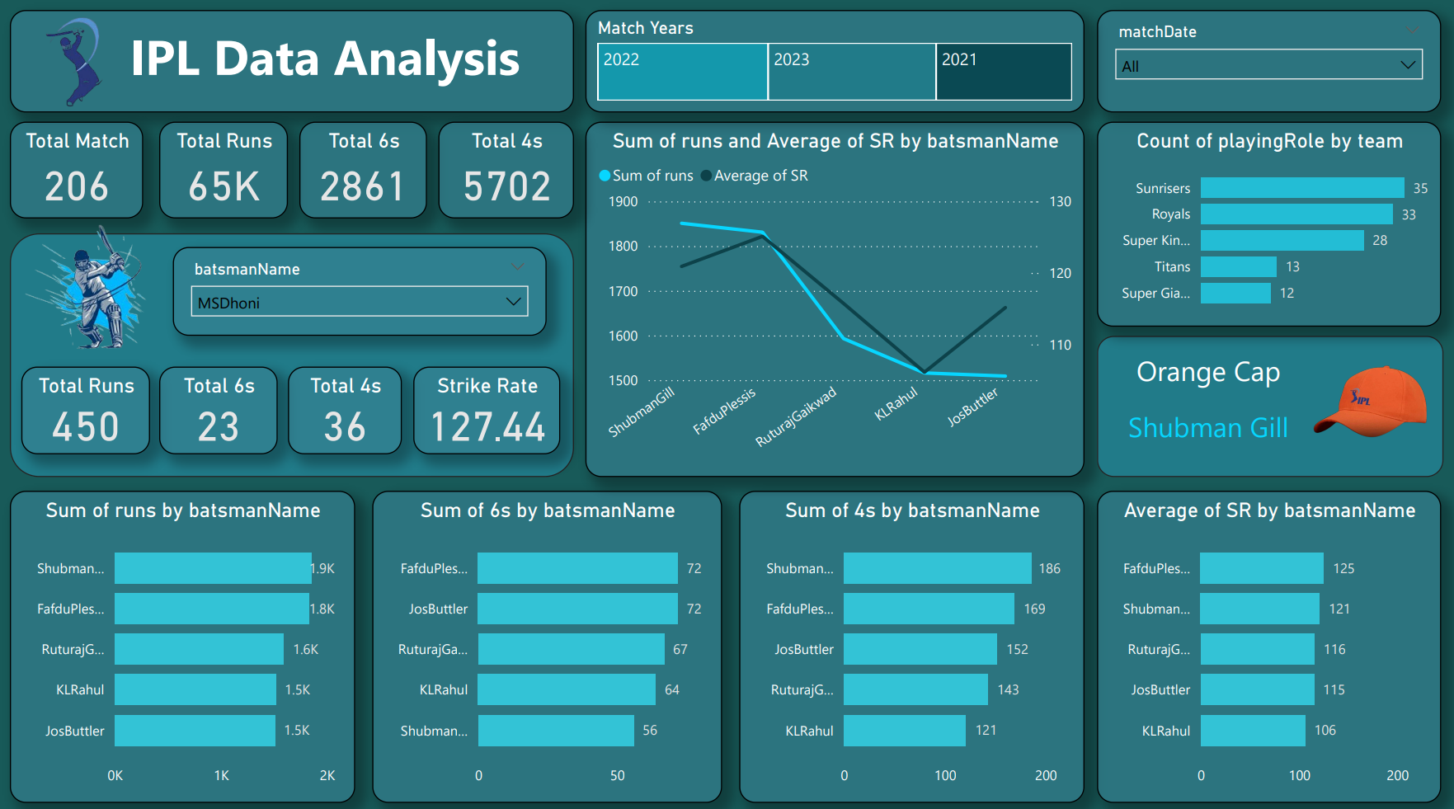
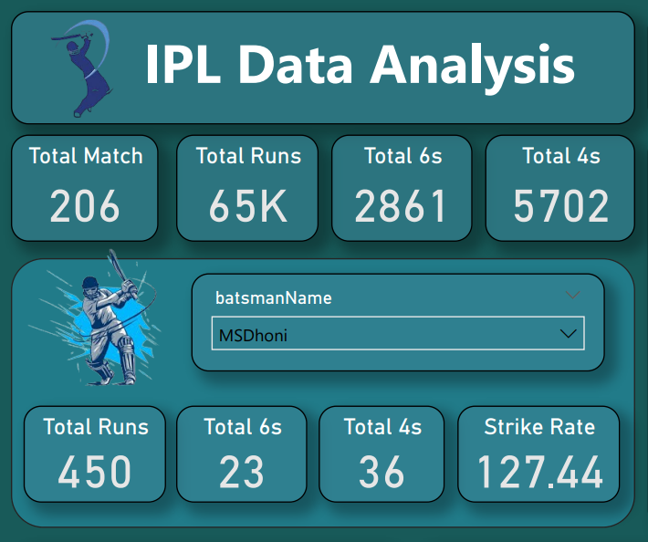

Match Analysis
Here we can see Total Match Number, Total Runs, Total 4s, Total 6s. I can find individual batsman runs, 4s, 6s and strike rate.
Mentorness

Slide 10
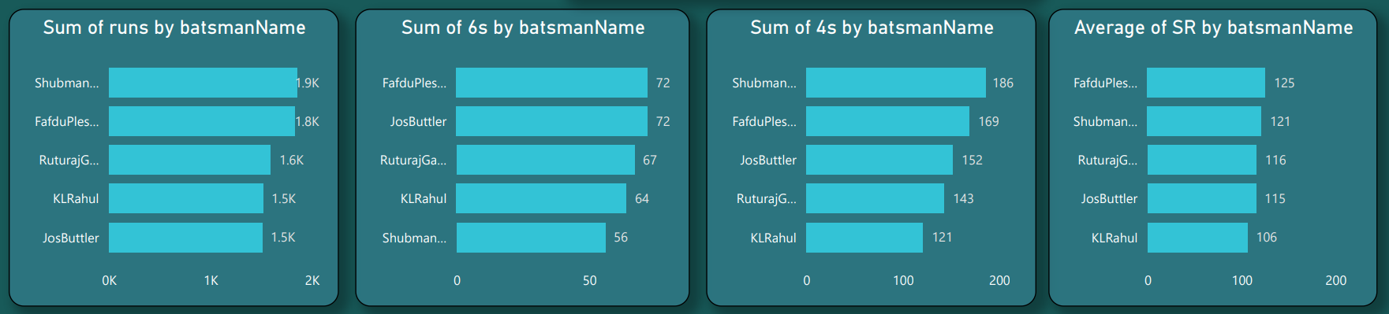
Top Batsman
Here we can see the highest runs, highest 6s, highest 4s, highest average strike rate of top 5 batsman in IPL.
Mentorness

Slide 11
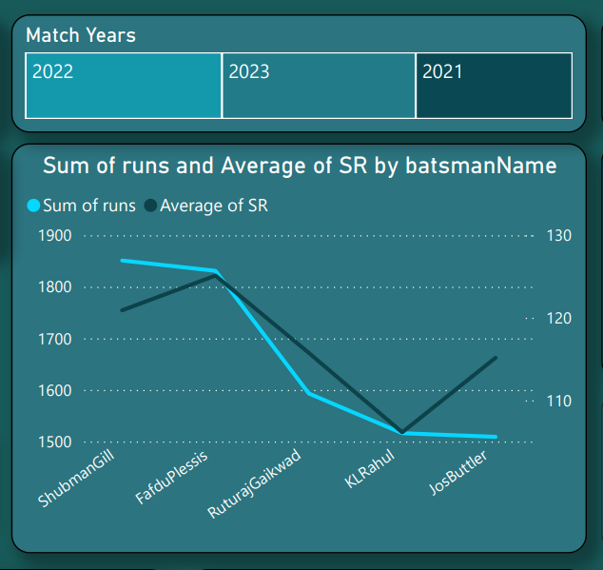
Top Batsman
Here we can see three different match years like 2021, 2022, 2023. Basically we can see the exact match analysis of different years. And other things Top 5 batsmen in IPL highest runs and highest average strike rate we can see through line graph.
Mentorness

Slide 12
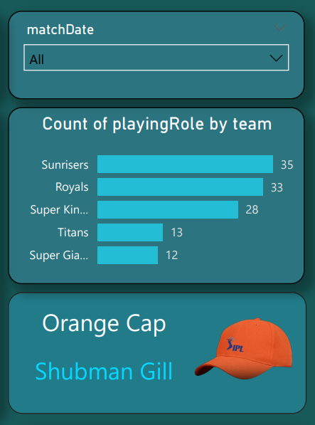
Top Batsman
Here we can see match date to select specific month, day, year. And among other things see the most batsmen and bowlers from the top 5 IPL teams. Only one batsman has scored most runs in IPL in all three seasons and that is Shubman Gill.
Mentorness

Slide 13
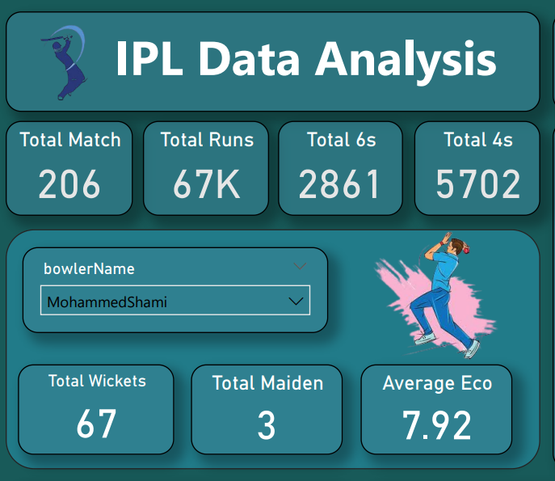
Match Analysis
Here we can see Total Match Number, Total Runs, Total 4s, Total 6s. I can find individual bowlers wickets, maiden overs, and average economy in IPL.
Mentorness

Slide 14
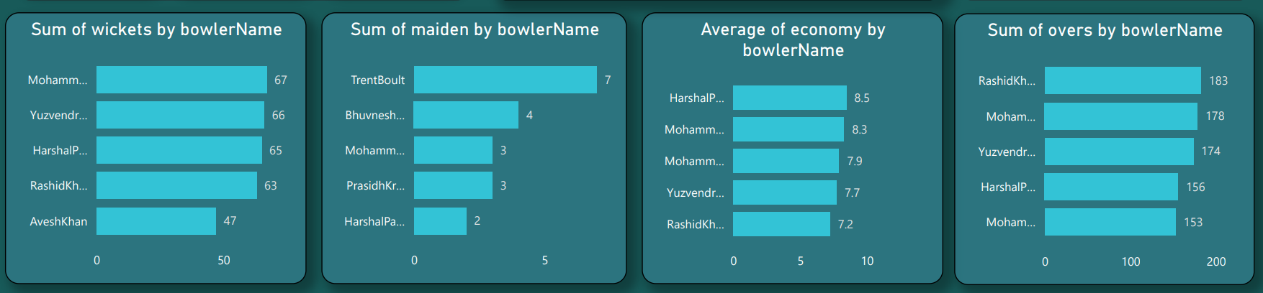
Top Bowlers
Here we can see the highest wickets, highest maiden overs, highest average economy, highest throwing a total over of top 5 bowlers in IPL.
Mentorness

Slide 15
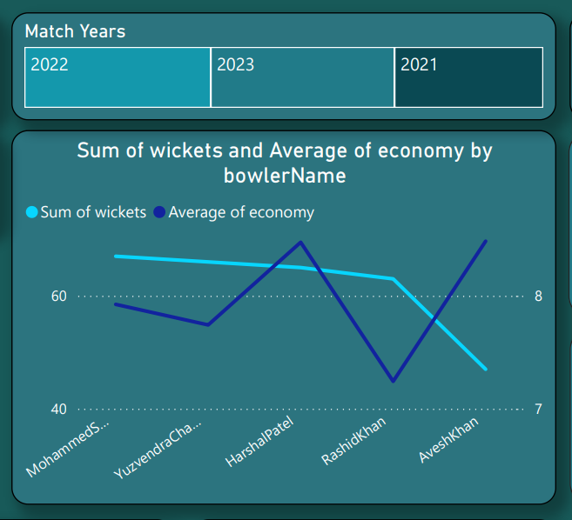
Top Bowlers
Here we can see three different match years like 2021, 2022, 2023. Basically we can see the exact match analysis of different years. And other things Top 5 bowlers in IPL highest wickets and highest average economy we can see through line graph.
Mentorness

Slide 16

Top Bowlers
Here we can see match date to select specific month, day, year. And among other things see the most batsman and bowlers from the top 5 IPL teams. Only one bowlers has scored most wickets in IPL in all three seasons and that is Mohammed Shami and best economy of the season that is Harshal Patel.
Mentorness

Slide 17
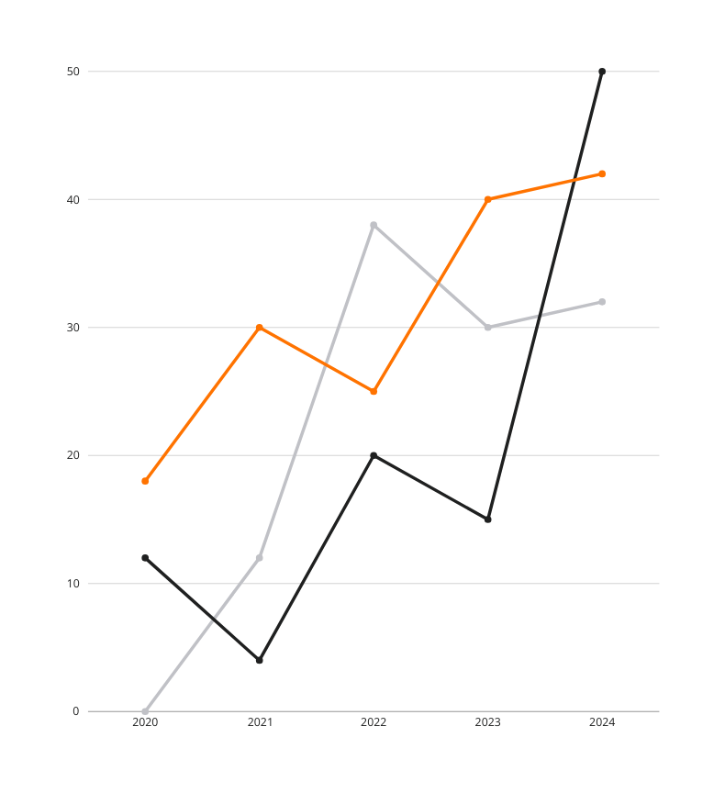
Key Insights
Here we can see three different match years like 2021, 2022, 2023.
Only one batsman has scored most runs in IPL in all three seasons and that is Shubman Gill.
Only one bowlers has scored most wickets in IPL in all three seasons and that is Mohammed Shami.
Only one bowlers has scored best economy of the season that is Harshal Patel.
The team that has won the most matches and reached the finals in this season is Chennai Super Kings.
Mentorness

Slide 18

Conclusion
Learn More
Mentorness

Slide 19
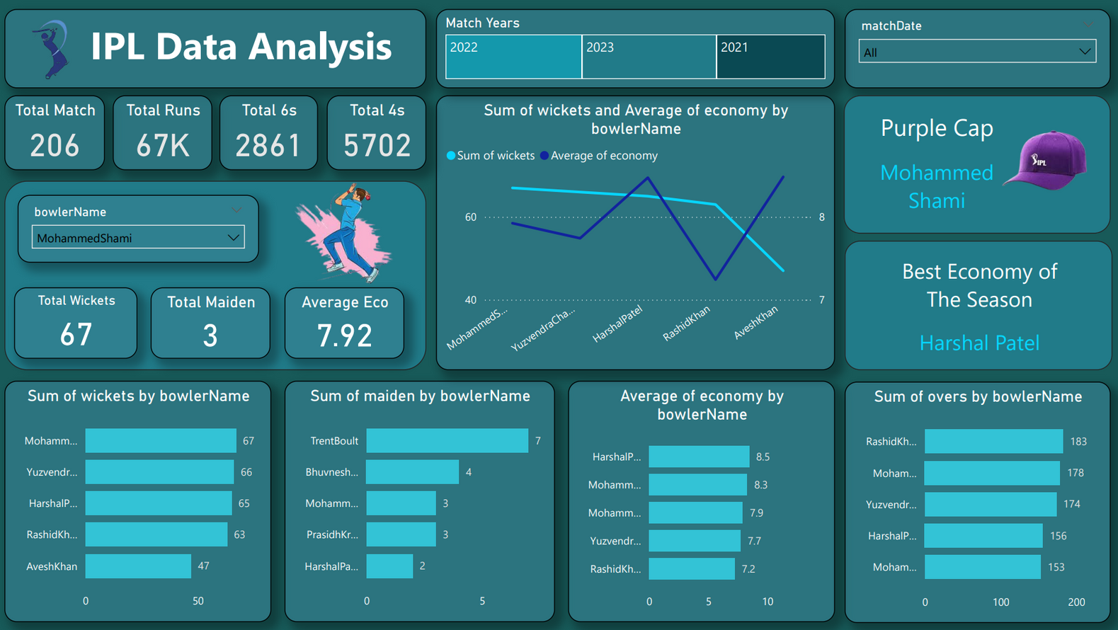
Conclusion
Learn More
Mentorness

Slide 20
THANK YOU
Batch Name :- MIP-DA-12
Presented By :- Preet Borad

